Slide 1
PLEASE TAKE A PIE… ☺

Slide 2
A few things to remember
Computer run on electricity
2 signals --- high voltage (1), low voltage (0)
We combine the high and low voltage to create signal, encode data (like morse code).
CT concept?
Notes:
CT concepts --- patterns. We use patterns of electrical impulses to code for meaningful information. The pattern concept is a two way street. You can use pattern recognition to find interesting trends in fuzzy data. You can also use patterns to encode information.

Slide 3
A few things to remember
A computer has 4 important processes
Input
Storage
Process
Output
These 4 processes are performed by the
input/output device
Systems bus
Memory storage
CPU
Notes:
Input device – keyboard
Output device --- monitor
Systems bus --- for communicating between different components of a computer
Memory storage --- for storing input, and also the outcomes of the computations
CPU --- where the calculations are performed. So memory holding input needs to send the data to the CPU, the CPU does the calculation, then sends the output to other memory.
This requires a fixed series of steps that keep iterating. This process is the CT concept of algorithm.

Slide 4
The binary code
Computer don’t understand human language
It interprets instructions in the form of electrical signals.
This is the binary code
The code is simple
1 and 0
The code has length
typically 8 characters long
In the code position matters and starts from 0 on the right
1100 means
0 at position 0,
0 at position 1,
1 at position 2,
and 1 at position 3
Each position is 1 bit

Slide 5
From binary to octal
Binary code of length 3 can encode at most up to 8 possible signals
2³ = 2 x 2 x 2 = 8
A length 3 binary code is also known as an octal
You can use this to encode numbers 0 to 7 (altogether 8 in all)

Slide 6
From binary to hexadecimal
Binary code of length 4 can encode at most up to 16 possible signals
2⁴ = 2 x 2 x 2 x 2 = 16
A length 4 binary code is known as a nibble
You can use this to encode numbers 0 to 9, A to F (altogether 16 in all)
If you pay attention, you will realize this is the basis of hexadecimal code
Since position matters, this is also permutation
Hexa means 6
Decimal means 10
So hexadecimal means…
A nibble is 4 bits

Slide 7
Question 1
You have heard of the basic unit of computing known as a byte.
You know that 2 nibbles makes one byte
And 1 nibble is 4 bits
How many hexadecimal symbols is needed to represent 1 byte?
Notes:
Answer is 2.
One hexadecimal is encoded by 4 bits of binary code.
Since 1 byte is 2 nibbles. It is 8 bits. There, you need 2 hexadecimal symbols to make 8 bits.

Slide 8
Putting the various codes next to each other
Hex | Binary | Octal | Decimal
0 | 0 | 0 | 0
1 | 1 | 1 | 1
2 | 10 | 2 | 2
3 | 11 | 3 | 3
4 | 100 | 4 | 4
5 | 101 | 5 | 5
6 | 110 | 6 | 6
7 | 111 | 7 | 7
8 | 1000 | 10 | 8
9 | 1001 | 11 | 9
A | 1010 | 12 | 10
B | 1011 | 13 | 11
C | 1100 | 14 | 12
D | 1101 | 15 | 13
E | 1110 | 16 | 14
F | 1111 | 17 | 15
4 bits
1 bit
3 bits
Familiar territory

Slide 9
The hexadecimal code
2 nibbles = 1 byte A byte is 8 bits
This is a binary string of length 16.
Difficult for humans to read since it is long
Solution
Split 16 into 4 x 4 sets
Each set has 4 binary characters
Use {0-9, A-F} to summarize each set
A byte can then be represented by 4 hexadecimal symbols instead of 16 binary symbols

Slide 10
Binary and hexadecimal

Slide 11
The CPU
The CPU has 3 main components
The Control Unit (CU) that fetches data from storage and performs decoding of commands and data from hexadecimal to binary
The Arithmetic and Logic Unit (ALU) executes the commands on the data
Memory registers are fast memory units in the CPU that stores information and commands
This collection of processes is also known as the “Fetch-Decode-Execute” cycle
Notes:
The computer only understands binary, which can be decoded into electrical impulses.
The use of hexadecimal is to make it easier to represent the information for us.

Slide 12
Ready?
Now let’s start the tutorial proper

Slide 13
1. What is the decimal value of the following binary numbers:

Slide 14
What do we know?
Decimal value are base 10 numbers --- These are values that we are familiar with in everyday use
Binary numbers are based on binary code and is a string of 1s and 0s.
In binary code, the length and positions matter.
Also, the first position starts from a count of 0

Slide 15
Introducing the N_{base} notation
A binary number such as ‘1001’ may be mistaken for one thousand and one, which is a decimal number.
01
To be more concise, we may express 1001 as 1001₂, where the 2 tells us that 1001 is a binary number.
02
Similarly, a decimal number may be expressed as X₁₀.
03

Slide 16
Let’s see how this works with 1 example
The binary code for 9₁₀ is 1001₂
So how do we go from 1001₂ to 9₁₀?

Slide 17
Converting binary to decimal
Starting from 1001₂
The length is 4
so if we start from 0, the highest power is 4 - 1 = 3
1001 -> (1 x 2³) #step 1
1001 -> (0 x 2²) #step 2
1001 -> (0 x 2¹) #step 3
1001 -> (1 x 2⁰) #step 4
So 1001₂ = (1 x 2³) + (0 x 2²) + (0 x 2¹) + (1 x 2⁰) = 8 + 0 + 0 + 1 = 9 #step 5

Slide 18
Decimal value lookup table
Binary | 2¹⁰ | 2⁹ | 2⁸ | 2⁷ | 2⁶ | 2⁵ | 2⁴ | 2³ | 2² | 2¹ | 2⁰
Decimal | 1024 | 512 | 256 | 128 | 64 | 32 | 16 | 8 | 4 | 2 | 1
1. What is the decimal value of the following binary numbers?
(a) (110000)₂
(b) (100001)₂ --- to do with your partners/yourself
(c) (1010101)₂ --- to do with your partners/yourself
Length = 6.
So highest power is 5.
Shortcut: Anything times 0 is 0 so we only do the first 2, can ignore the rest
110000 = (1 x 2⁵) + (1 x 2⁴) + .. (0 x 2⁰) = 32 + 16 = 48

Slide 19
5 minutes to try

Slide 20
2. What is the binary value of the following decimal numbers?

Slide 21
What do we know?
We need to work iteratively through the series of base 2 powers
Find the highest power of 2 that is equals or lower to the number
We keep subtracting off until nothing is left

Slide 22
Let’s see how this works with 1 example
The binary code for 9₁₀ is 1001₂
So how do we go from 9₁₀ to 1001₂

Slide 23
Converting binary to decimal
Starting from 9₁₀
The highest power using base 2 is 3.
so we know the binary code should be of length 3 + 1 = 4 (i.e. ????₂)
(1 x 2³) = 8 1???₂ #step 1
9₁₀ – 8₁₀ = 1₁₀ #step 2
There are no values with base 2 and powers of 2 and 1 that are smaller than 1 so therefore, 100?₂ #step 3
Anything with the power of 0 would be 1, so therefore, 1 x 2⁰ = 1. We get 1001₂. #step 4
We have also solved the problem since 1₁₀ – 1₁₀ = 0 and there is no remainder #step 5

Slide 24
Decimal value lookup table
Binary | 2¹⁰ | 2⁹ | 2⁸ | 2⁷ | 2⁶ | 2⁵ | 2⁴ | 2³ | 2² | 2¹ | 2⁰
Decimal | 1024 | 512 | 256 | 128 | 64 | 32 | 16 | 8 | 4 | 2 | 1
2. What is the binary value of the following decimal numbers:
(a) 73
(b) 353 --- to do with your partners/yourself
(c) 923 --- to do with your partners/yourself
The highest power is 6.
Therefore Length = 7.
2⁶ = 64
73 – 64 = 9
And we have 1??????₂
Since we have 9 left. Power of 5 and 4 would be 0 since they are too big.
And we have 100????₂
Power of 3 gives us 8 which is smaller than 9.
9 – 8 = 1
And we have 1001???₂
Since we have 1 left. Power of 2 and 1 would be 0 since they are too big.
Power of 0 gives us 1, which is equals to 1
And we solve to get 1001001₂
1 – 1 = 0 (end of problem)

Slide 25

5 minutes to try

Slide 26
3. What is the decimal value of the following hexadecimal numbers:

Slide 27
What do we know?
Hexadecimal contains 16 symbols from 0 to 15.
However, double digits can be confusing.
So we go from 0 to 9, and A to F.
A to F codes for values 10 to 15
Decimal means base 10
Binary means base 2
Hexadecimal means base 16

Slide 28
Converting hexadecimal to decimal
Same procedure as interpreting binary numbers.
Only this time, we use base 16 to various powers instead of base 2.
Also, instead of 0 and 1, values can range between 0 to 15
If you see a letter from A to F, you convert them from 10 to 15 respectively

Slide 29
Hexadecimal value lookup table
Weight |  | Positional value
Decimal | Hexadecimal | 16⁵ | 16⁴ | 16³ | 16² | 16¹ | 16⁰
0 | 0 | 0 | 0 | 0 | 0 | 0 | 0
1 | 1 | 1048576 | 65536 | 4096 | 256 | 16 | 1
2 | 2 | 2097152 | 131072 | 8192 | 512 | 32 | 2
3 | 3 | 3145728 | 196608 | 12288 | 768 | 48 | 3
4 | 4 | 4194304 | 262144 | 16384 | 1024 | 64 | 4
5 | 5 | 5242880 | 327680 | 20480 | 1280 | 80 | 5
6 | 6 | 6291456 | 393216 | 24576 | 1536 | 96 | 6
7 | 7 | 7340032 | 458752 | 28672 | 1792 | 112 | 7
8 | 8 | 8388608 | 524288 | 32768 | 2048 | 128 | 8
9 | 9 | 9437184 | 589824 | 36864 | 2304 | 144 | 9
10 | A | 10485760 | 655360 | 40960 | 2560 | 160 | 10
11 | B | 11534336 | 720896 | 45056 | 2816 | 176 | 11
12 | C | 12582912 | 786432 | 49152 | 3072 | 192 | 12
13 | D | 13631488 | 851968 | 53248 | 3328 | 208 | 13
14 | E | 14680064 | 917504 | 57344 | 3584 | 224 | 14
15 | F | 15728640 | 983040 | 61440 | 3840 | 240 | 15
The very nice hexadecimal conversion table
Do NOT memorize this.

Slide 30
Hexadecimal value lookup table
Weight |  | Positional value
Decimal | Hexadecimal | 16⁵ | 16⁴ | 16³ | 16² | 16¹ | 16⁰
0 | 0 | 0 | 0 | 0 | 0 | 0 | 0
1 | 1 | 1048576 | 65536 | 4096 | 256 | 16 | 1
2 | 2 | 2097152 | 131072 | 8192 | 512 | 32 | 2
3 | 3 | 3145728 | 196608 | 12288 | 768 | 48 | 3
4 | 4 | 4194304 | 262144 | 16384 | 1024 | 64 | 4
5 | 5 | 5242880 | 327680 | 20480 | 1280 | 80 | 5
6 | 6 | 6291456 | 393216 | 24576 | 1536 | 96 | 6
7 | 7 | 7340032 | 458752 | 28672 | 1792 | 112 | 7
8 | 8 | 8388608 | 524288 | 32768 | 2048 | 128 | 8
9 | 9 | 9437184 | 589824 | 36864 | 2304 | 144 | 9
10 | A | 10485760 | 655360 | 40960 | 2560 | 160 | 10
11 | B | 11534336 | 720896 | 45056 | 2816 | 176 | 11
12 | C | 12582912 | 786432 | 49152 | 3072 | 192 | 12
13 | D | 13631488 | 851968 | 53248 | 3328 | 208 | 13
14 | E | 14680064 | 917504 | 57344 | 3584 | 224 | 14
15 | F | 15728640 | 983040 | 61440 | 3840 | 240 | 15
3. What is the decimal value of the following hexadecimal numbers:
(a) (4a70)₁₆
(b) (ab)₁₆ --- to do with your partners/yourself
(c) (ffff)₁₆ --- to do with your partners/yourself

Slide 31
How to convert hexadecimal to decimal
4a70₁₆ -> 4 x 16³ #step 1
4a70₁₆ -> 10 x 16² #step 2
4a70₁₆ -> 7 x 16¹ #step 3
4a70₁₆ -> 0 x 16⁰ #step 4
4a70₁₆ = (4 x 16³) + (10 x 16²) + (7 x 16¹) + (0 x 16⁰) = 19056 #step 5

Slide 32
5 minutes to try

Slide 33
4. What is the hexadecimal value of the following numbers

Slide 34
Hexadecimal value lookup table
Weight |  | Positional value
Decimal | Hexadecimal | 16⁵ | 16⁴ | 16³ | 16² | 16¹ | 16⁰
0 | 0 | 0 | 0 | 0 | 0 | 0 | 0
1 | 1 | 1048576 | 65536 | 4096 | 256 | 16 | 1
2 | 2 | 2097152 | 131072 | 8192 | 512 | 32 | 2
3 | 3 | 3145728 | 196608 | 12288 | 768 | 48 | 3
4 | 4 | 4194304 | 262144 | 16384 | 1024 | 64 | 4
5 | 5 | 5242880 | 327680 | 20480 | 1280 | 80 | 5
6 | 6 | 6291456 | 393216 | 24576 | 1536 | 96 | 6
7 | 7 | 7340032 | 458752 | 28672 | 1792 | 112 | 7
8 | 8 | 8388608 | 524288 | 32768 | 2048 | 128 | 8
9 | 9 | 9437184 | 589824 | 36864 | 2304 | 144 | 9
10 | A | 10485760 | 655360 | 40960 | 2560 | 160 | 10
11 | B | 11534336 | 720896 | 45056 | 2816 | 176 | 11
12 | C | 12582912 | 786432 | 49152 | 3072 | 192 | 12
13 | D | 13631488 | 851968 | 53248 | 3328 | 208 | 13
14 | E | 14680064 | 917504 | 57344 | 3584 | 224 | 14
15 | F | 15728640 | 983040 | 61440 | 3840 | 240 | 15
4. What is the hexadecimal value of the following numbers:
(a) 353
(b) 1000 --- to do with your partners/yourself
(c) 262145 --- to do with your partners/yourself

Slide 35
How to convert decimal to hexadecimal
Note something that you should be doing by hand regularly anyway
Check against the hexadecimal table.
Find n x 16^{x} which is equals or smaller than the number you are converting from
Get the remainder
Check against the hexadecimal table.
Find n x 16^{x} which is equals or smaller than the number you are converting from
Do this until you have no remainder

Slide 36
Hexadecimal value lookup table
Weight |  | Positional value
Decimal | Hexadecimal | 16⁵ | 16⁴ | 16³ | 16² | 16¹ | 16⁰
0 | 0 | 0 | 0 | 0 | 0 | 0 | 0
1 | 1 | 1048576 | 65536 | 4096 | 256 | 16 | 1
2 | 2 | 2097152 | 131072 | 8192 | 512 | 32 | 2
3 | 3 | 3145728 | 196608 | 12288 | 768 | 48 | 3
4 | 4 | 4194304 | 262144 | 16384 | 1024 | 64 | 4
5 | 5 | 5242880 | 327680 | 20480 | 1280 | 80 | 5
6 | 6 | 6291456 | 393216 | 24576 | 1536 | 96 | 6
7 | 7 | 7340032 | 458752 | 28672 | 1792 | 112 | 7
8 | 8 | 8388608 | 524288 | 32768 | 2048 | 128 | 8
9 | 9 | 9437184 | 589824 | 36864 | 2304 | 144 | 9
10 | A | 10485760 | 655360 | 40960 | 2560 | 160 | 10
11 | B | 11534336 | 720896 | 45056 | 2816 | 176 | 11
12 | C | 12582912 | 786432 | 49152 | 3072 | 192 | 12
13 | D | 13631488 | 851968 | 53248 | 3328 | 208 | 13
14 | E | 14680064 | 917504 | 57344 | 3584 | 224 | 14
15 | F | 15728640 | 983040 | 61440 | 3840 | 240 | 15
4. What is the hexadecimal value of the following numbers:
353
256 is the biggest we can get first (1 x 16²)
353 – 256 = 97
96 is the next biggest we can get (6 x 16¹)
97 – 96 = 1
1 is the last value we will need (1 x 16⁰)
And we solve since 1 – 1 = 0
353₁₀ = 161₁₆

Slide 37
Hexadecimal value lookup table
Weight |  | Positional value
Decimal | Hexadecimal | 16⁵ | 16⁴ | 16³ | 16² | 16¹ | 16⁰
0 | 0 | 0 | 0 | 0 | 0 | 0 | 0
1 | 1 | 1048576 | 65536 | 4096 | 256 | 16 | 1
2 | 2 | 2097152 | 131072 | 8192 | 512 | 32 | 2
3 | 3 | 3145728 | 196608 | 12288 | 768 | 48 | 3
4 | 4 | 4194304 | 262144 | 16384 | 1024 | 64 | 4
5 | 5 | 5242880 | 327680 | 20480 | 1280 | 80 | 5
6 | 6 | 6291456 | 393216 | 24576 | 1536 | 96 | 6
7 | 7 | 7340032 | 458752 | 28672 | 1792 | 112 | 7
8 | 8 | 8388608 | 524288 | 32768 | 2048 | 128 | 8
9 | 9 | 9437184 | 589824 | 36864 | 2304 | 144 | 9
10 | A | 10485760 | 655360 | 40960 | 2560 | 160 | 10
11 | B | 11534336 | 720896 | 45056 | 2816 | 176 | 11
12 | C | 12582912 | 786432 | 49152 | 3072 | 192 | 12
13 | D | 13631488 | 851968 | 53248 | 3328 | 208 | 13
14 | E | 14680064 | 917504 | 57344 | 3584 | 224 | 14
15 | F | 15728640 | 983040 | 61440 | 3840 | 240 | 15
5 minutes to try
What is the hexadecimal value of the following numbers:
(a) 353
(b) 1000 --- to do with your partners/yourself
(c) 262145 --- to do with your partners/yourself

Slide 38

Code arithmetic

Slide 39
Adding binaries
Rule set
 | 0 | 0 | 1 | 1
+ | 0 | 1 | 0 | 1
 | 0 | 1 | 1 | ?
 |  | 1
+ |  | 1
 | 1 | 0

Slide 40
Qn 5a: (11001)₂ + (11011)₂ =?
 | 1 | 1 | 0 | 0 | 1
+ | 1 | 1 | 0 | 1 | 1
 |  |  |  | 1
 | 1 | 1 | 0 | 0 | 1
+ | 1 | 1 | 0 | 1 | 1
 |  |  |  |  | 0
 |  |  | 1 | 1
 | 1 | 1 | 0 | 0 | 1
+ | 1 | 1 | 0 | 1 | 1
 |  |  |  | 0 | 0

Slide 41
(11001)₂ + (11011)₂ =?
 |  |  | 1 | 1
 | 1 | 1 | 0 | 0 | 1
+ | 1 | 1 | 0 | 1 | 1
 |  |  | 1 | 0 | 0
 | 1 |  | 1 | 1
 | 1 | 1 | 0 | 0 | 1
+ | 1 | 1 | 0 | 1 | 1
 |  | 0 | 1 | 0 | 0
1 | 1 |  | 1 | 1
 | 1 | 1 | 0 | 0 | 1
+ | 1 | 1 | 0 | 1 | 1
1 | 1 | 0 | 1 | 0 | 0
(11001)₂ + (11011)₂ = (110100)₂

Slide 42
Adding hexadecimals
Simple way is to use the hexadecimal addition table
Or we convert to decimals first: A₁₆ = 10₁₀
5₁₆ = 5₁₀ Therefore A₁₆ + 5₁₆ = 15₁₀
And 15₁₀ = F₁₆
A₁₆ + 5₁₆ = ?
A₁₆ + 5₁₆ = F₁₆

Slide 43
Qn 5b: (7c4)₁₆ + (31b)₁₆ = ?
 | 7 | c | 4
+ | 3 | 1 | b
 |  |  | F
 | 7 | c | 4
+ | 3 | 1 | b
 |  | D | F
 | 7 | c | 4
+ | 3 | 1 | b
 | A | D | F
(7c4)₁₆ + (31b)₁₆ = ADF₁₆

Slide 44
Subtracting binaries
Rule set
 | 0 | 0 | 1 | 1
- | 0 | 1 | 0 | 1
 | 0 | ? | 1 | 0
 | Borrow | 1 1
 | 1 | 0
- |  | 1
 |  | 1

Slide 45
Qn 5c: (1100)₂ - (1011)₂ = ?
 |  | 1 | 1 | 0 | 0
- |  | 1 | 0 | 1 | 1
 |  |  |  | 1 1 | 1 1
 |  | 1 | 1 | 0 | 0
- |  | 1 | 0 | 1 | 1
 |  |  |  |  | 1
 |  |  |  | 1 1 | 1 1
 |  | 1 | 1 | 0 | 0
- |  | 1 | 0 | 1 | 1
 |  |  |  | 0 | 1

Slide 46
Qn 5c: (1100)₂ - (1011)₂ = ?
 |  |  |  | 1 1 | 1 1
 |  | 1 | 1 | 0 | 0
- |  | 1 | 0 | 1 | 1
 |  |  |  | 0 | 1
 |  |  |  | 1 1 | 1 1
 |  | 1 | 1 | 0 | 0
- |  | 1 | 0 | 1 | 1
 |  |  | 0 | 0 | 1
 |  |  |  | 1 1 | 1 1
 |  | 1 | 1 | 0 | 0
- |  | 1 | 0 | 1 | 1
 |  | 0 | 0 | 0 | 1

Slide 47
Subtracting hexadecimals
The subtraction of hexadecimal numbers follow the same rules as the subtraction of numbers in any other number system.
The only variation is in borrowed number. In the decimal system, you borrow a group of 10₁₀.
In the binary system, you borrow a group of 2₁₀.
In the hexadecimal system you borrow a group of 16₁₀.

Slide 48
5d: (7c4)₁₆ - (31b)₁₆ = ?
 |  |  | 7 | c | 4
- |  |  | 3 | 1 | b
B is larger than 4. So we have to borrow
 |  |  |  |  | 4 + 16
 |  |  | 7 | c | 4
- |  |  | 3 | 1 | b
Recall that b is actually 11.
 |  |  |  |  | 4 + 16
 |  |  | 7 | c | 4
- |  |  | 3 | 1 | 11
 |  |  |  |  | 9

Slide 49
5d: (7c4)₁₆ - (31b)₁₆ = ?
 |  |  |  |  | 4 + 16
 |  |  | 7 | c | 4
- |  |  | 3 | 1 | 11
 |  |  |  |  | 9
If you removed 1 from c, it becomes b, which is 11
 |  |  |  |  | 4 + 16
 |  |  | 7 | c 11 | 4
- |  |  | 3 | 1 | 11
 |  |  |  | 10 | 9
10 is A in hexadecimal code
 |  |  |  |  | 4 + 16
 |  |  | 7 | c 11 | 4
- |  |  | 3 | 1 | 11
 |  |  |  | A | 9

Slide 50
5d: (7c4)₁₆ - (31b)₁₆ = ?
 |  |  |  |  | 4 + 16
 |  |  | 7 | c 11 | 4
- |  |  | 3 | 1 | 11
 |  |  | 4 | A | 9
(7c4)₁₆ - (31b)₁₆ = (4A9)₁₆

Slide 51
6. What is the minimum number of bits that are required to uniquely represent the 26 characters of the English alphabet?

Slide 52
Thinking about encoding space
4 bits provides 2⁴ = 16 possible letters, which is not enough. However, 5 bits provides 2⁵ = 32 possible letters which can encode the entire English alphabet.
Qn: You have 4 bases --- A, T, G, C. How many positions do you need to encode for 20 amino acids?
Ans: 3 (4 x 4 x 4 = 64) --- This is also known as the triplet code
Notes:
4 x 4 x 4 = 64

Slide 53
7. The American Standard Code for Information Interchange (ASCII) is a standard for converting characters for electronic communications.

Slide 54
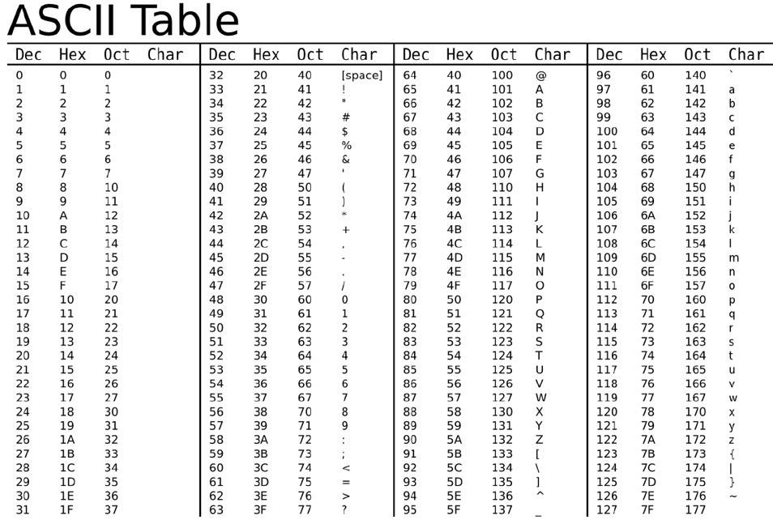
Decode into characters the following hexadecimal string:
0x5468697320697320746f6f20656173792021
Impt: Each character will correspond to a unique 8-bit value (represented with two hexadecimal characters)
Impt: the prefix 0x is often used to denote an hexadecimal representation

Slide 55
Decode into characters the following hexadecimal string:
Qn: 0x5468697320697320746f6f20656173792021
Ans: This is too easy!

Slide 56
8. What value will be present in memory position 0x6f after finishing executing the instructions? Use the Fetch-Decode-Execute cycle and consider that we are using 16-bit size instructions.

Slide 57
What do we know?
CPU has 4 registers RA, RB, RC, RD
16-bit system --- use hexadecimal code
Notation: 0x1Aij --- 0x 1 A ij
0x (denotes hexadecimal; can ignore)
1 (1 means to sum)
A (place in register A)
i and j are the 2 data to be summed

Slide 58
What do we know?
Notation: 0x {1,2,3,4} {A,B,C,D} ij
0x (denotes hexadecimal; can ignore)
1: Sum, 2: Subtract, 3: Load, 4: Save
A,B,C,D (place in register A,B,C,D)
i and j are the 2 data to be dealt with

Slide 59
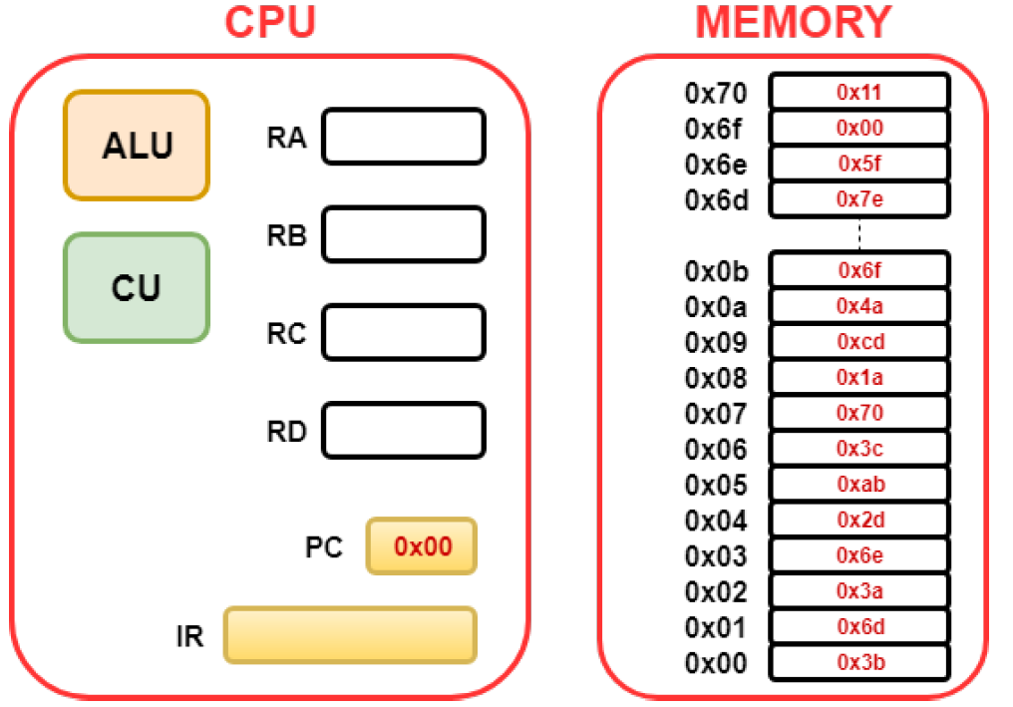
The Fetch-Decode-Execute cycle
Timer state
Instruction or data

Slide 60
PC state | Operand |  | Instruction |  | Hex Value
0 | 3b | 6d | Load data into position B | From 6d | 7e
2 | 3a | 6e | Load data into position A | From 6e | 5f
4 | 2d | ab | Subtract and store in D | b - a | 7e – 5f = 1f
6 | 3c | 70 | Load data into position C | From 70 | 11
8 | 1a | cd | Sum and store in A | c+ d | 1f+11 = 30
A (remember A is 10) | 4a | 6f | Save data in register A | To location 6f | 30
Hint: Use a hex calculator to speed things up https://www.calculator.net/hex-calculator.html

Slide 61
9. Describe what values should be written in the memory in order to compute the addition of 0x44 and 0x55, and placing the result into memory position 0x70.

Slide 62
PC state | Operand |  | Instruction |  | Hex Value
0 | 3a | 6d | Load data into position A | From 6d | 44
2 | 3b | 6e | Load data into position B | From 6e | 55
4 | 1c | ab | Sum and store into C | a + b | 55 + 44 = 99
6 | 4c | 70 | Save value in position C | To location 70 | 99
Only needs 4 cycles --- PC will stop at 6

Slide 63
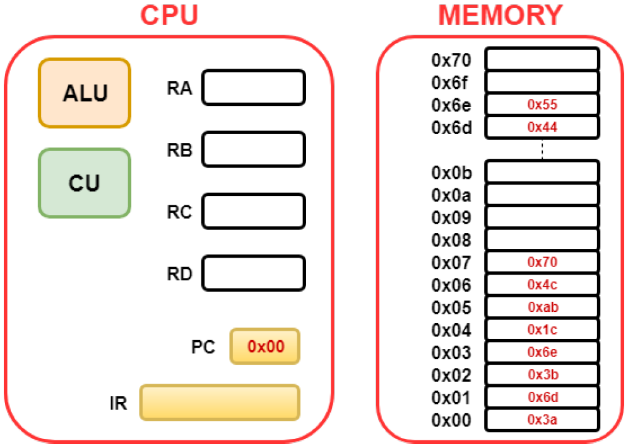

Slide 64
The end!

Slide 65
New instruction for practical
When logged into the RPi. Open command line.
Go to “/Desktop/”
Key in command ”ls”
If you see a file named “helloworld”
Type in ”rm hello*.*”
Proceed with the rest of practical as normal
At the end of the practical, please also delete and remove your helloworld files. Thanks! ☺

Slide 66
Do not do this unless you see the problem! Otherwise your Pi is FINE!
how to update the time zone so that you can access the internet
go to the command prompt
type in:
sudo date -s “month e.g 01/day e.g 01/2020 hh:min"
hidden menu
sudo rm -r ~/.config/lxpanel
sudo reboot

Slide 67
Copyrights
This set of tutorial explanations belongs to Wil Goh (except the kitten pictures).

